Slide 1



AI Master Class series – Day 9
Introduction to Deep Learning & its Libraries

Slide 2
Day-9 Agenda.
01.
02.
03.
Overview on Deep Learning
Neurons & Activation Function
Deep Learning Libraries
04.
Applications of Deep Learning
What is Deep Learning | Why DL | CPU vs GPU
Overview about neurons & Types of activation function
Overview on DL Libraries & How to install it
DL application in various domain

Slide 3
Deep Learning in AI.
ARTIFICIAL INTELLIGENCE
MACHINE LEARNING
DEEP LEARNING

Slide 4
Deep Learning.
Recognition
Brain
Vision
Training
Dataset
Model
Recognition

Slide 5
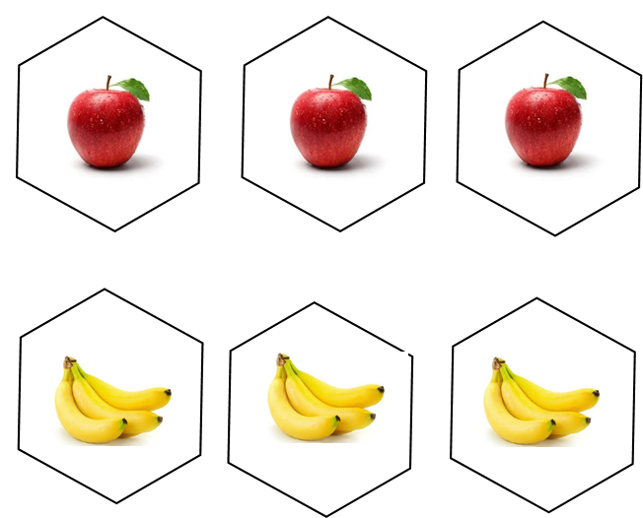

Why Deep Learning ?
Prediction
AI
Automatic Feature Extraction
Input Data
It’s an apple

Slide 6
Why GPU ?
“It Can train more number of data in short time period & Better for real time AI based application”
GPU – Graphical Processing Unit
100%
High Bandwidth | Thread Parallelism | Easily programmable registers | Bandwidth Optimized
CPU –Central Processing Unit
50%
Less Bandwidth | Latency Optimised | Not suitable for Real time application where performance is the main Factor

Slide 7
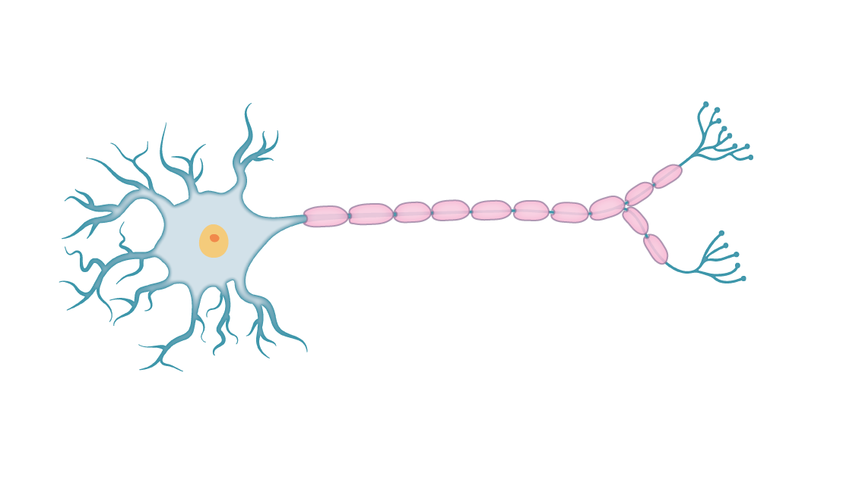
Neuron & Activation Function.
Cell Body
Neuron
Dendrites
Synapse
Axon
Like a Human Brain, here a Neuron takes input and do some function to give the output
Function going to be the Mathematical function
Those Function is known as ACTIVATION function
Activation Function
Step Function
Sigmoid Function
Tanh Function
ReLU Function
Neuron
Inputs
OUTPUT
Activation Fn.

Slide 8
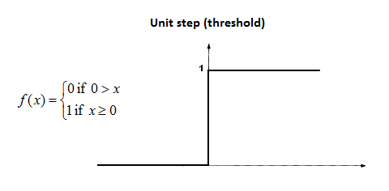
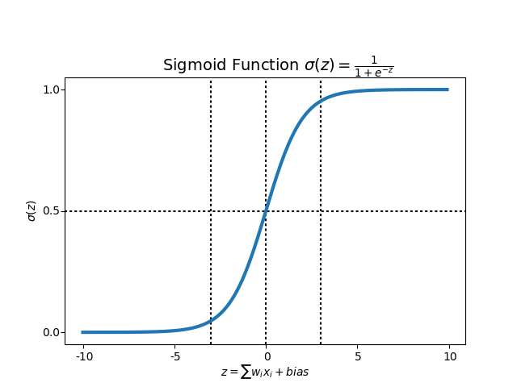
Activation Function.
STEP Function
If value of X is greater than or equal to 0, then output is 1, If value of X is less than 0, then output is 0
Since step Function is non differentiable to zero, it can’t do the gradient descent method, so it can’t update weights.
SIGMOID Function
If value of X is infinity, then output is 1, If value of X is negative infinity, then output is 0
It captures non-linearity in the data
It can use Gradient descent & Back propagation method to calculate weights.
Output range [0,1]

Slide 9
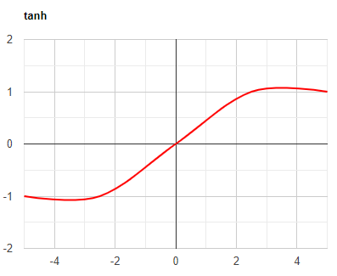
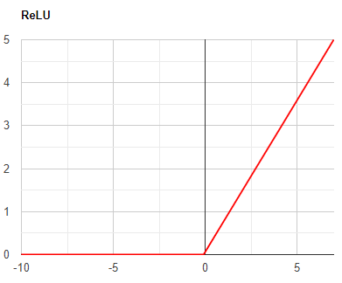
Activation Function.
Tanh Function
Rescaled of Sigmoid Function
Output range [-1,1]
Better learning rate requires, higher gradient. In some times, for the data is centred around 0, derivatives are higher.
ReLU Function
Rectified Linear Unit. if any negative input is detected, it returns 0, otherwise it returns the value back.
Leaky ReLU Function
Same as ReLU, like returning same for Positive. But for negative values instead of returning zero, it has constant slope

Slide 10
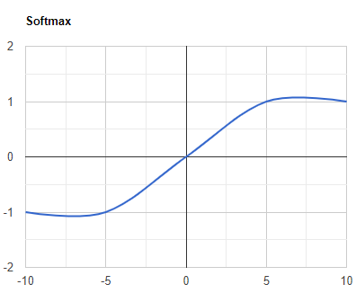
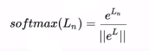
Activation Function.
SOFTMAX Function
Softmax activation function will be applied in the last layer of Neural network, instead of ReLU, tanh, Sigmoid.
It is used to map the non-normalized output of a network to a probability distribution over predicted output class. That is it converts output of last layer into a essential probability distribution.

Slide 11


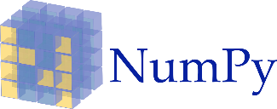
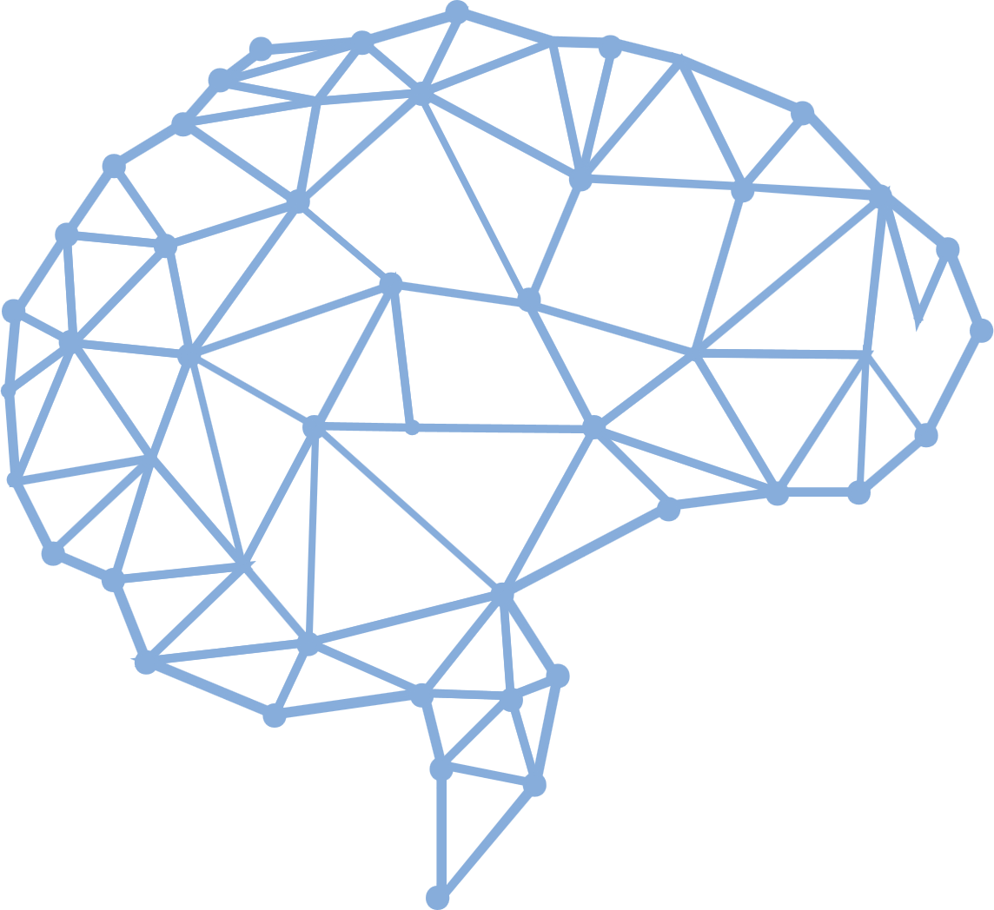




Deep Learning Libraries
Keras
Tensor Flow
Framework for Deep learning | Same code for CPU & GPU | Uses Theano/TF as Backend | CNN | not support multi GPU
Numerical computation using data flow graphs | Backend for Keras | Distributed computing on multiple GPU
Torch
Numerical Python & Scientific Python
Old ML & DL library | Supports CUDA - Compute Unified Device Architecture for parallel computation | Supervised image problem with CNN
Basic operation such as Sorting, Reshaping, indexing | Scientific computing | Most new feature belong in SciPy rather than Numpy
Caffe
Caffe is a deep learning framework made with expression, speed, and modularity in mind.Very high performance | Tuning Hyper parameters | CNN & RNN(Facebook extends) | | CPU & GPU
Mxnet
Apache MXNet is an open-source deep learning software framework, used to train, and deploy deep neural networks|More number of Language Bindings | Distributed computing

Slide 12

Practical session

Slide 13
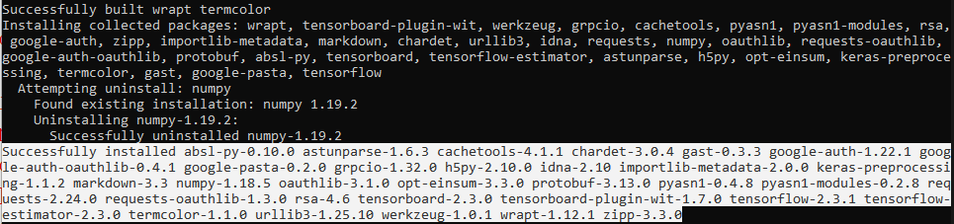
Installing Libraries
TensorFlow: pip install tensorflow

Slide 14
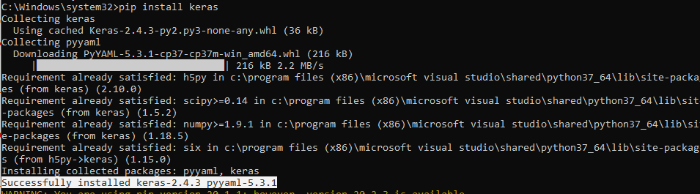
Installing Libraries
Keras: pip install keras

Slide 15
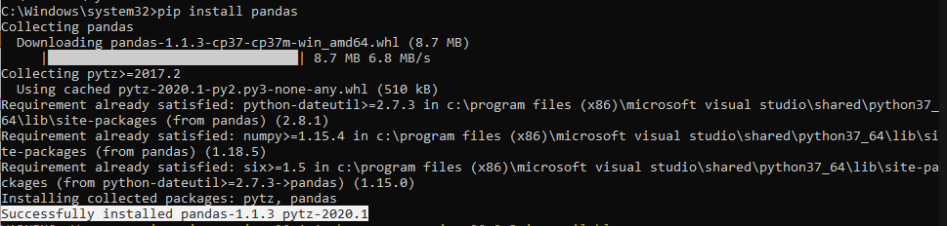
Installing Libraries
pandas: pip install pandas

Slide 16
Installing Libraries
pandas: pip install scipy==1.1.0

Slide 17
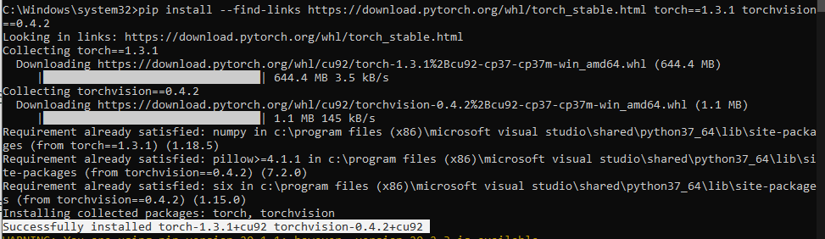
Installing Libraries
pytorch: pip3 install --find-links https://download.pytorch.org/whl/torch_stable.html torch==1.3.1 torchvision==0.4.2

Slide 18
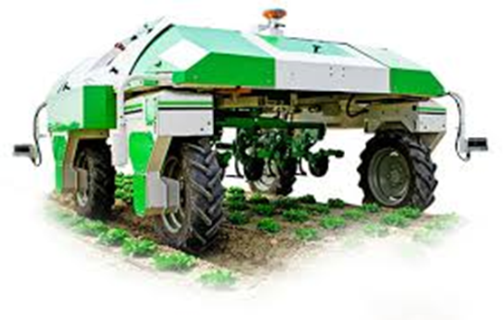
Applications of Deep Learning.
Fruit & vegetable classification
AI in Cooking
AI in Cooking
AI in Autonomous Vehicle
AI Doctor
Prediction of Disease from Medical Image
Voice recognition for ALS Patient

Slide 19
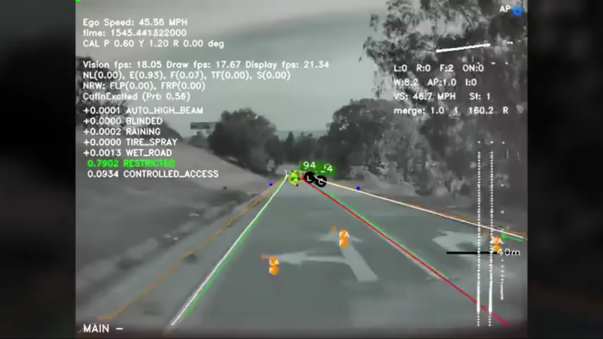

Slide 20

AI News – Day 9. July - 2020
Researchers from Tencent, along with other Chinese scientists, are using deep learning to predict critical COVID-19 cases.
The deep learning model was trained on data from 1590 patients from 575 medical centers across China, with further validation from 1393 patients.

Slide 21

Thanks!
Tomorrow session
Do you have any questions?
sanjay@pantechmail.com
www.pantechsolutions.net
Designing your First Neural Network

